Slide 1
HTML

Slide 2
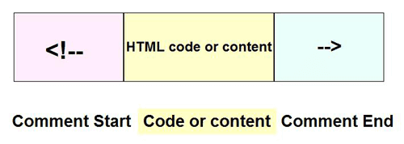
Comments in HTML
This is part of code that should not be parsed.
<!-- This is an HTML Comment -->

Slide 3
Bold, Italic, Superscript & Subscript
<b> : By enclosing words in the tags<b> and </b> we can make characters appear bold.
<i> : By enclosing words in the tags <i> and </i> we can make characters appear italic
<u> : By enclosing words in the tags <u> and </u> we can make characters appear underline
<sup> : The <sup> element is used to contain characters that should be superscript such as the suffixes of dates or mathematical concepts like raising a number to a power such as 2^{2.}
<sub> : The <sub> element is used to contain characters that should be subscript. It is commonly used with foot notes or chemical formulas such as H₂0.

Slide 4
Escape Characters
There are some characters that are used in and reserved by HTML code.
For example, the left and right-angled brackets.
Therefore, if you want these characters to appear on your page you need to use what are termed "escape" characters.
For example, to write a left angled bracket, you can use either &lt
For an ampersand, you can use either &amp.

Slide 5
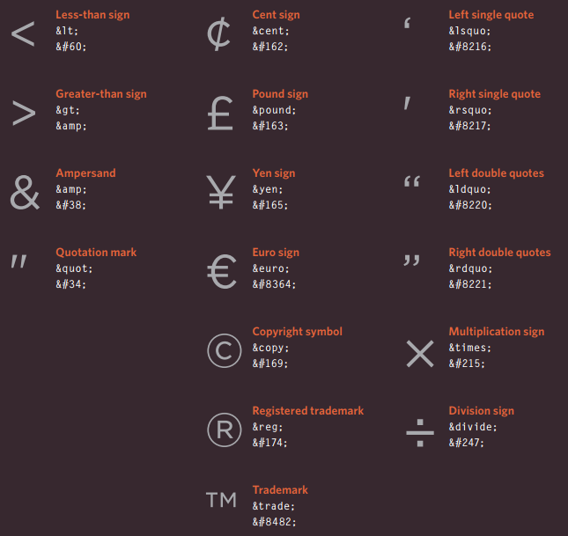

Slide 6
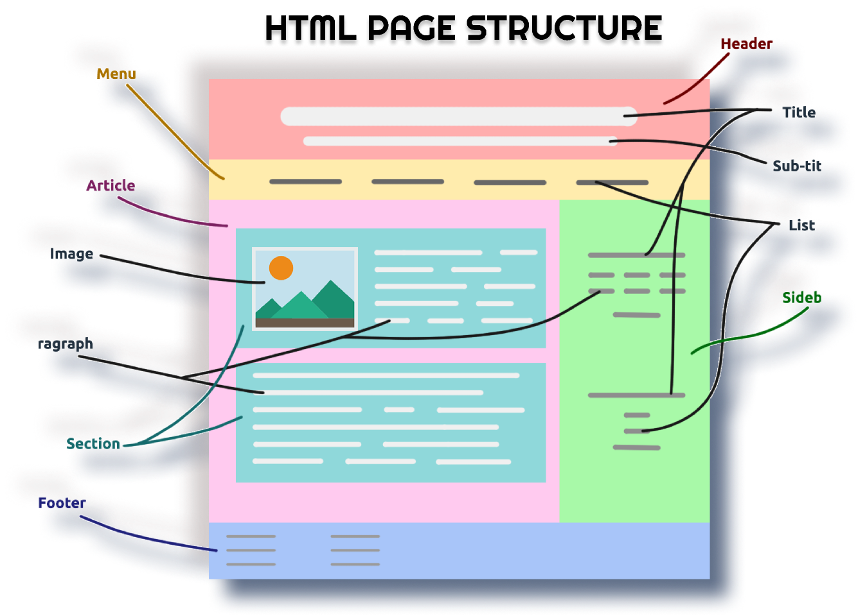

Slide 7
HTML 5

Slide 8
Introduction
It has improved the markup available for documents and has introduced application programming interfaces (API) and Document Object Model (DOM).
Features:
It has introduced new multimedia features which supports both audio and video controls by using <audio> and <video> tags.
There are new graphics elements including vector graphics and tags.
Enrich semantic content by including <header> <footer>, <article>, <section> and <figure>.
Web storage facility which provides web application methods to store data on the web browser.
Uses SQL database to store data offline.
Allows drawing various shapes like triangle, rectangle, circle, etc.
Capable of handling incorrect syntax.
Easy DOCTYPE declaration i.e., <!doctype html>
Easy character encoding i.e., <meta charset=”UTF-8″>

Slide 9
Advantages:
All browsers supported.
More device friendly.
Easy to use and implement.
HTML 5 in integration with CSS, JavaScript, etc. can help build beautiful websites.
Disadvantages:
Long codes have to be written which is time consuming.
Only modern browsers support it.

Slide 10
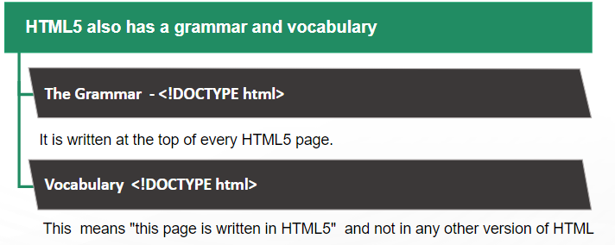
<!DOCTYPE> in HTML5

Slide 11
SEMANTIC MARKUP
There are some text elements that are not intended to affect the structure of your web pages, but they do add extra information to the pages — they are known as semantic markup.
The reason for using these elements is that other programs, such as screen readers or search engines, can use this extra information.

Slide 12
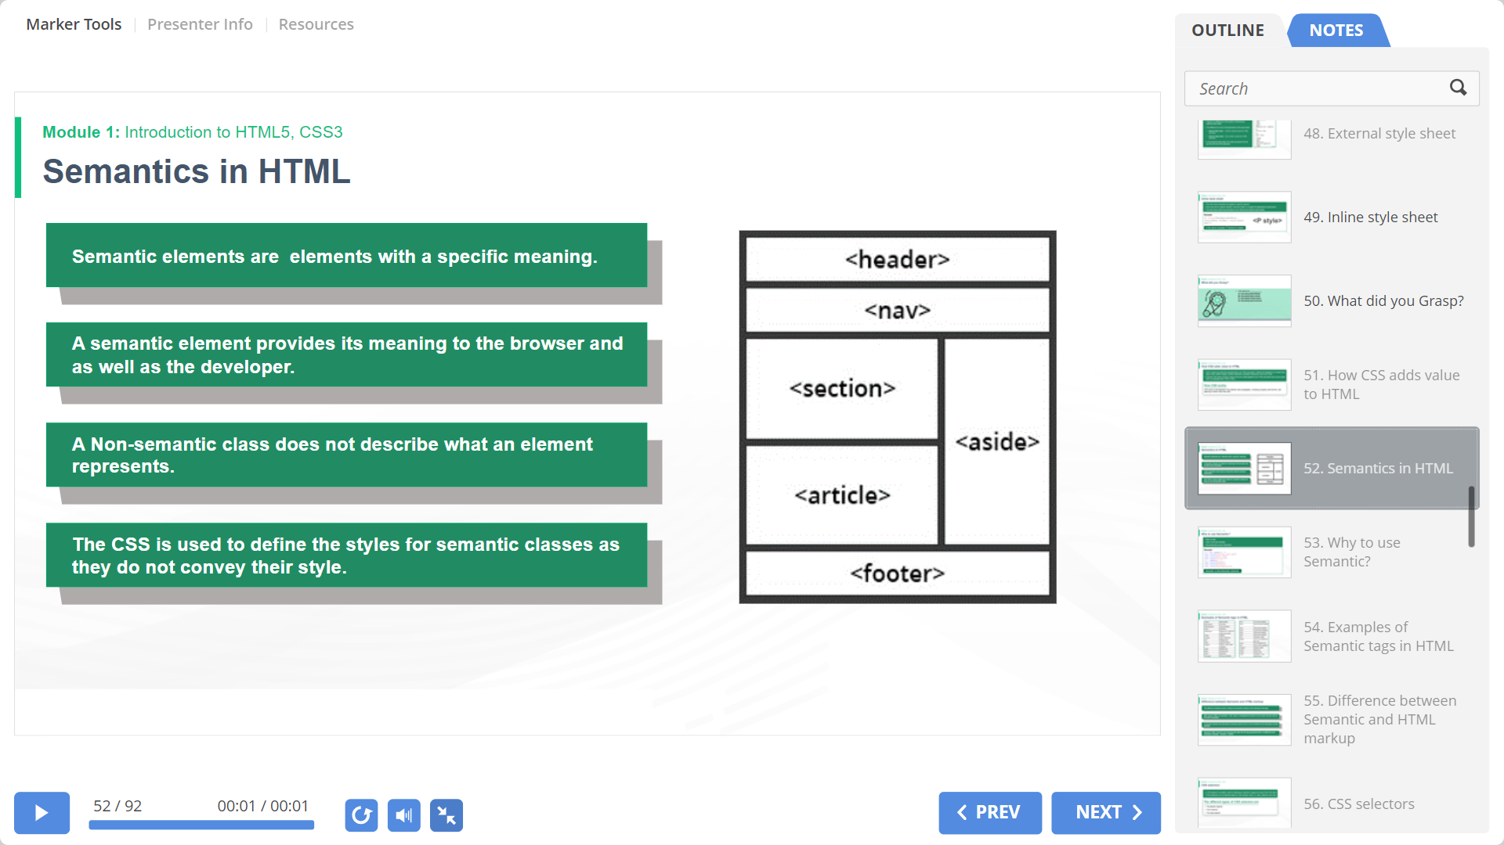
Semantics in HTML
“Semantic” HTML5 tags enables web-developer to define the HTML5 designs more logically.
With the help of Semantics, document content can be organized in logical sections.
They can now logically create sections, figures, captions, headers, footers, sidebars and panels of navigation.
What makes the tags semantic is that they define the content so that search engines can semantically (i.e. intelligently) “see” the design of the document.
One of the semantic element’s functions is to make a website more convenient for optimizing the search engine.

Slide 13
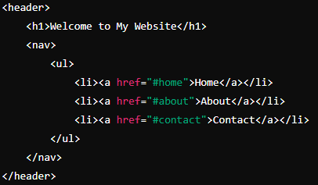
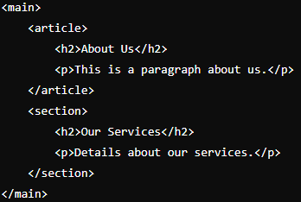
Semantic HTML uses elements that clearly describe their meaning in a human and machine readable way. This helps both browsers and search engines understand the content and its context, leading to better accessibility and SEO.
Examples:
<header>: Represents the introductory content or navigational aids of a section or page.
<article>: Represents a self-contained piece of content that could be distributed or reused independently.
<footer>: Represents the footer of a section or page, typically containing metadata or related links.
<section>: Represents a thematic grouping of content, typically with its own heading.
<nav>: Represents a block of navigation links.

Slide 14
The <main> tag specifies the main content of a document.
The content inside the <main> element should be unique to the document. It should not contain any content that is repeated across documents such as sidebars, navigation links, copyright information, site logos, and search forms.
There must not be more than one <main> element in a document. The <main> element must NOT be a descendant of an <article>, <aside>, <footer>, <header>, or <nav> element.

Slide 15
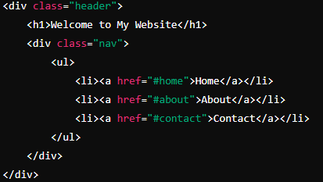
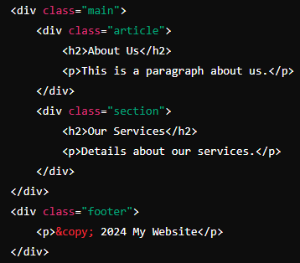
Non-semantic (Generic) HTML elements do not convey any information about the content they enclose. They are used for layout and styling purposes but do not provide any semantic meaning to the content inside them.
Examples:
<div>: A generic container for grouping content without implying any specific meaning.
<span>: A generic inline container used for styling or grouping inline elements without adding any semantic meaning.

Slide 16
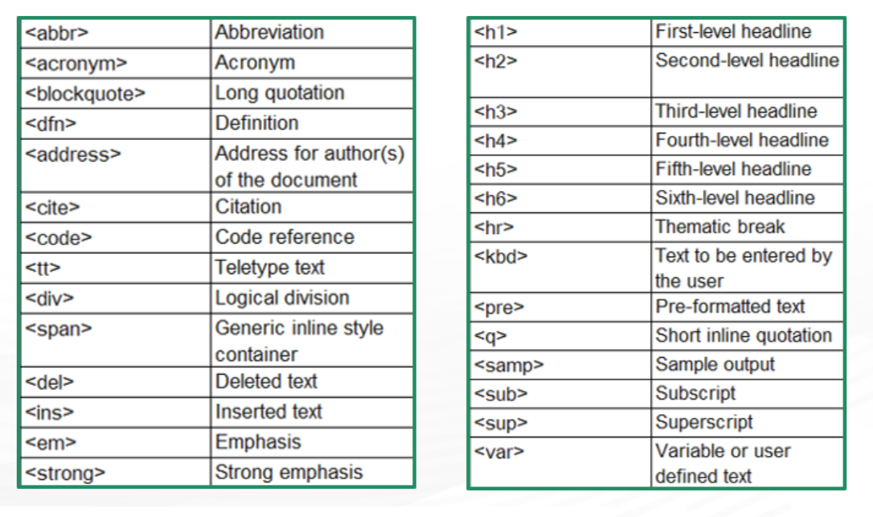
Example of Semantic tags in HTML

Slide 17


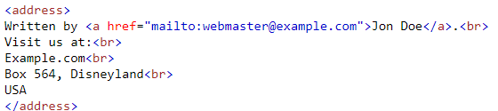


HTML <abbr> Tag
HTML <address> Tag
The address element
HTML <blockquote> Tag
The <blockquote> tag specifies a section that is quoted from another source.
HTML <dfn> Tag
Output:

Slide 18
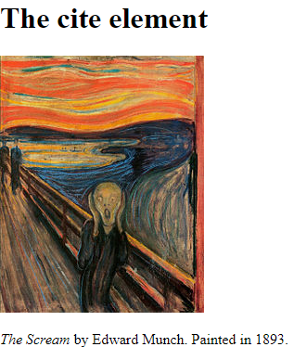
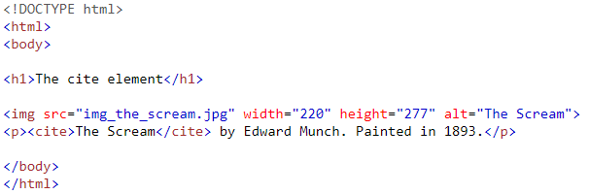
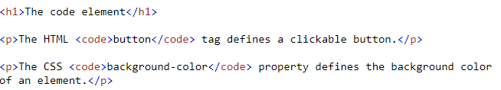
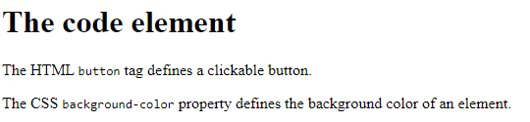
HTML <cite> Tag
HTML <code> Tag

Slide 19







HTML <del> Tag and
HTML <ins> Tag
Output:
HTML <em> Tag
HTML <strong> Tag
HTML <kbd> Tag

Slide 20



Output:
HTML <sup> Tag and
HTML <sub> Tag
HTML <samp> Tag: is used to define sample output from a computer program. The content inside is displayed in the browser's default monospace font.
HTML <var> Tag
HTML <q> Tag

Slide 21
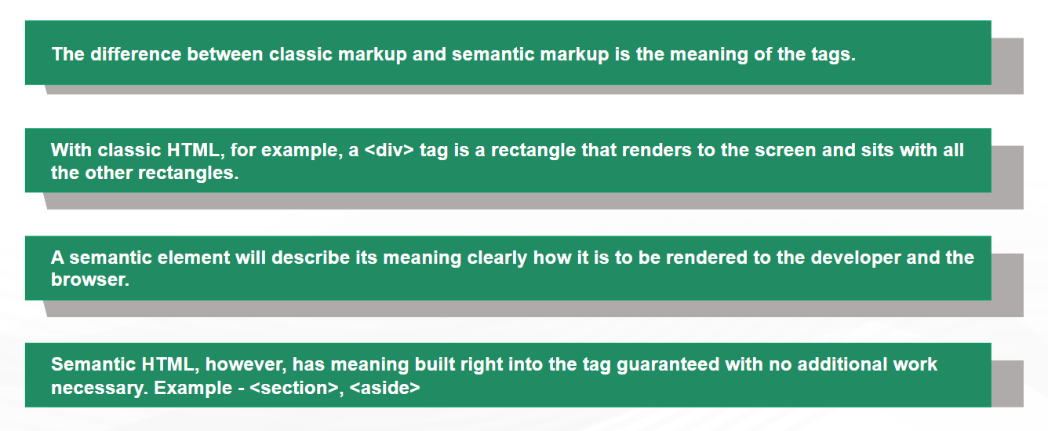
Difference between Semantic and HTML markup

Slide 22
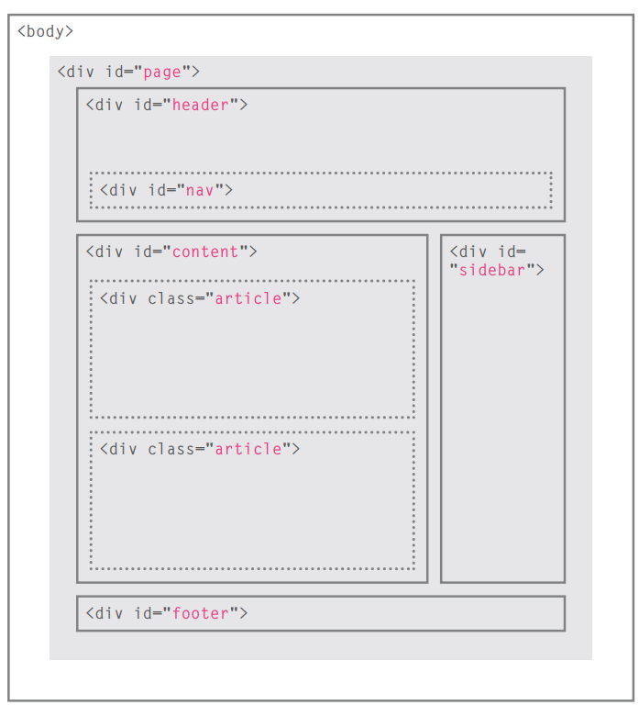
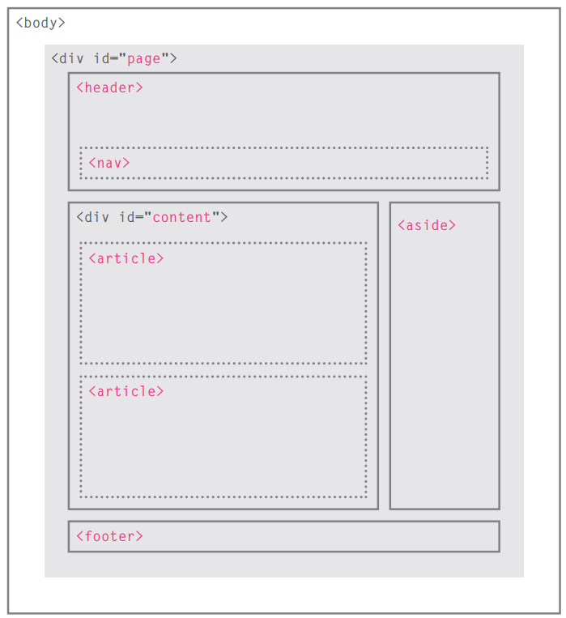
Creating web pages with HTML5

Slide 23
The following tags have been introduced for better structure –
section: This tag represents a generic document or application section. It can be used together with h1-h6 to indicate the document structure.
article: This tag represents an independent piece of content of a document, such as a blog entry or newspaper article.
aside: This tag represents a piece of content that is only slightly related to the rest of the page.
header: This tag represents the header of a section.
footer: This tag represents a footer for a section and can contain information about the author, copyright information etc.
nav: This tag represents a section of the document intended for navigation.
dialog: This tag can be used to mark up a conversation.
figure: This tag can be used to associate a caption together with some embedded content, such as a graphic or video.

Slide 24
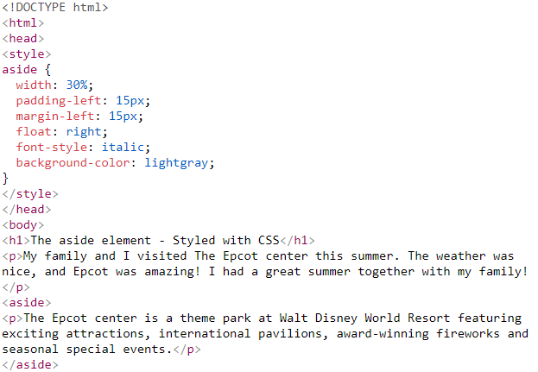
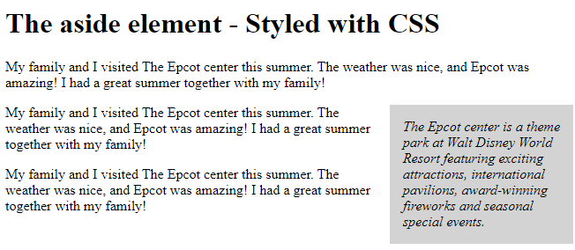
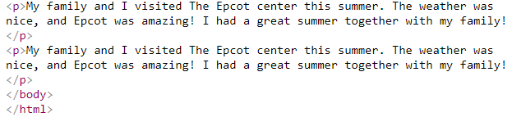

Slide 25
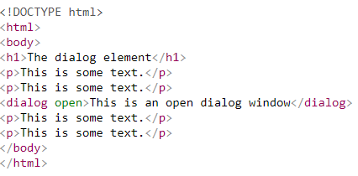
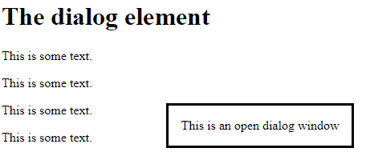

Slide 26
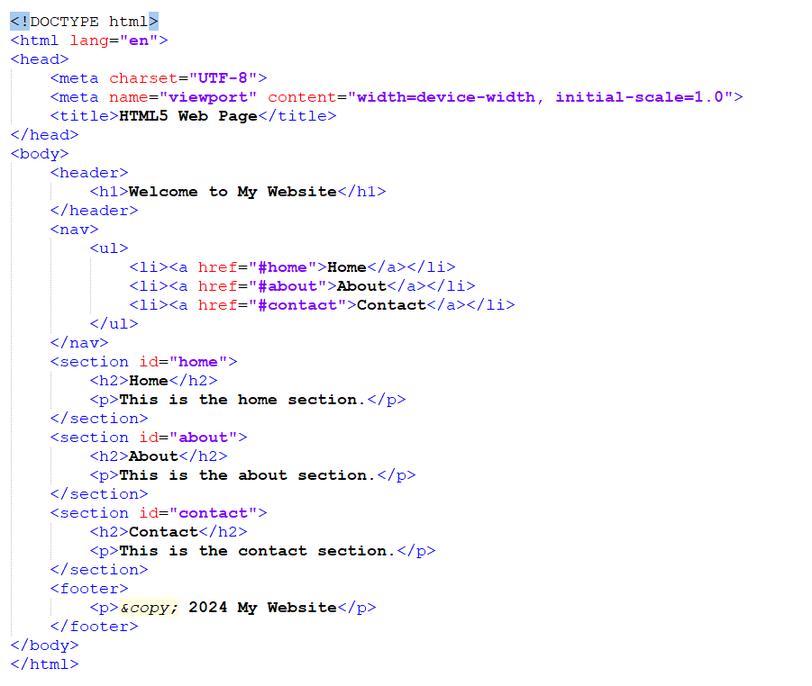
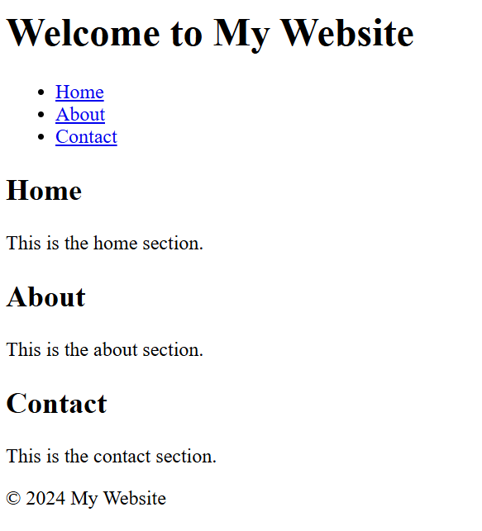
Example

Slide 27
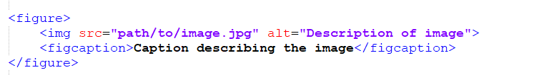
HTML5: Figure And Figure Caption
HTML5 has introduced a new <figure> element to contain images and their caption so that the two are associated.
Enhances accessibility and SEO.

Slide 28
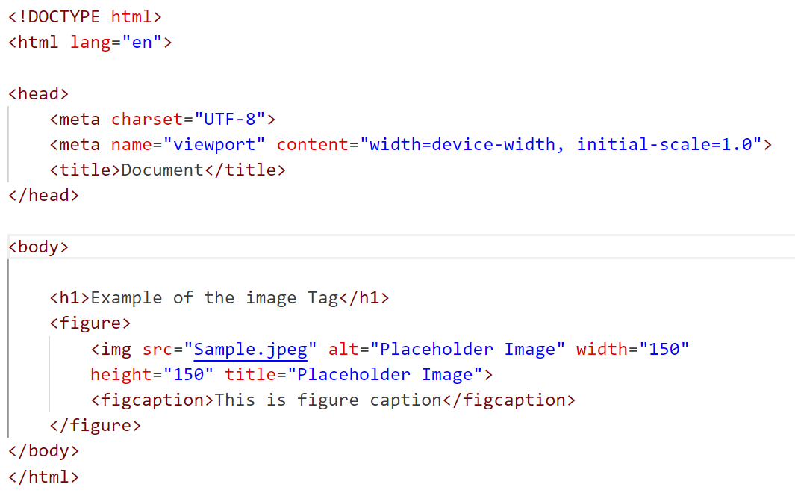
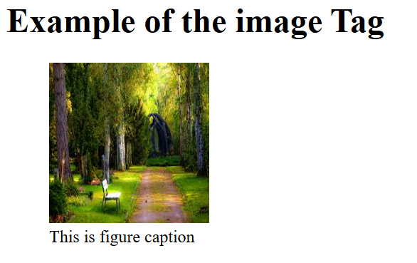
Output:

Slide 29
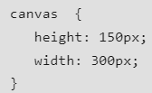
HTML <canvas> Tag
The <canvas> tag in HTML is used to draw graphics on a web page using JavaScript. It can be used to draw paths, boxes, texts, gradients, and adding images. By default, it does not contain borders and text.
Syntax:
The following are the default values for <canvas> element that can be displayed by most of the Browsers:

Slide 30
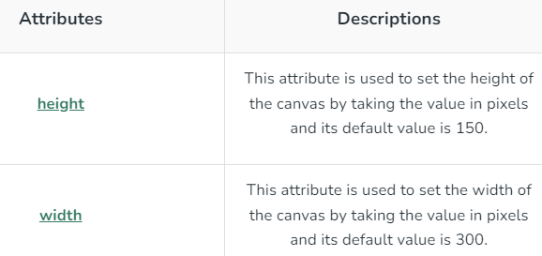
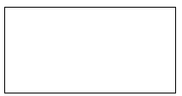
Create a canvas element with a width of 200 pixels and a height of 100 pixels, displayed with a black border.
<!DOCTYPE html>
<html>
<body>
<canvas id=“ABC" width="200" height="100" style="border:1px solid black">
</canvas>
</body>
</html>

Slide 31
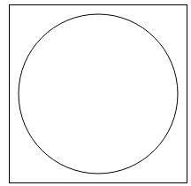
Create a 200×200 canvas with ID “first” displays a black-bordered circle at coordinates (100,100) using HTML5 Canvas.
<!DOCTYPE html>
<html>
<body>
<canvas id=“first" height="200" width="200" style="border:1px solid black">
</canvas>
<script>
var c = document.getElementById(“first");
var cx = c.getContext("2d");
cx.beginPath();
cx.arc(100, 100, 90, 0, 2 * Math.PI);
cx.stroke();
</script>
</body>
</html>

Slide 32

Create a 200×200 canvas with ID “second” displays a radial gradient that transitions from red to green, filling the entire canvas using HTML5 Canvas.
<!DOCTYPE html>
<html>
<body>
<canvas id=“second" width="200" height="200" style="border:1px solid black">
</canvas>
<script>
var c = document.getElementById(“second");
var cx = c.getContext("2d");
var grd = cx.createRadialGradient (100, 100, 5, 100, 100, 100);
grd.addColorStop(0, "red");
grd.addColorStop(1, "green");
cx.fillStyle = grd;
cx.fillRect(0, 0, 200, 200);
</script>
</body>
</html>

Slide 33

Audio tag
The <audio> tag is an inline element that is used to embed sound files into a web page.
It is a useful tag if you want to add audio such as songs, interviews, etc. on your webpage.
Syntax:
Using the <source> element enables the specification of various audio files, allowing the browser to choose the compatible format.
The <audio> element allows integration with JavaScript, enabling the creation of custom audio controls and behaviors.
The ‘controls’ attribute provides buttons for managing audio, like play, pause, and volume adjustment.

Slide 34
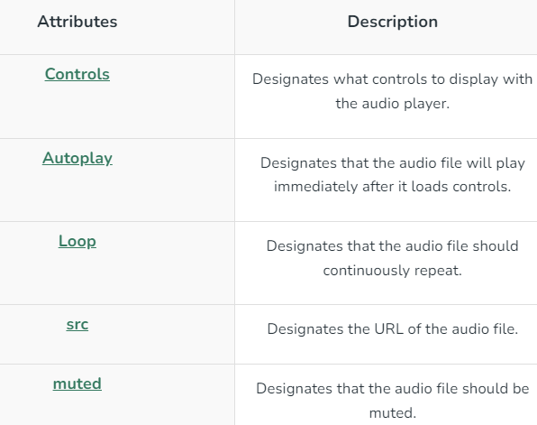

Slide 35
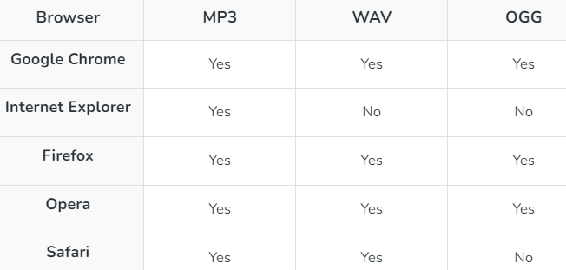
Supported Formats:
Autoplay is disabled in most Chromium browsers, but muted autoplay is still allowed. Three formats mp3, ogg, and wav are supported by HTML5. The support for each format by different browsers is given below :

Slide 36

Example 1 (Adding audio to Webpage): The controls attribute is used to add audio controls such as play, pause, and volume. The “source” element is used to specify the audio files which the browser may use. The first recognized format is used by the browser.
<!DOCTYPE html>
<html> <body>
<p>Audio Sample</p>
<!-- audio tag starts here -->
<audio controls>
<source src= “source1.mp3" type="audio/mp3">
</audio>
<!-- audio tag ends here -->
</body>
</html>

Slide 37
<!DOCTYPE html>
<html>
<body>
<audio controls autoplay>
<source src= “source1.mp3" type="audio/mp3">
</audio>
</body>
</html>
The autoplay attribute is used to automatically begin playback of the audio file whenever the URL of the webpage is loaded.
<!DOCTYPE html>
<html>
<body>
<audio controls muted>
<source src= “source1.mp3" type="audio/mp3">
</audio>
</body>
</html>
The muted attribute specifies that the audio should be muted on the webpage.

Slide 38

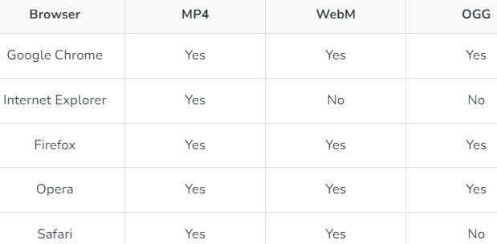
Video tag
The <video> element in HTML allows you to embed video content directly into web pages. It supports various video formats, including MP4, WebM, and Ogg.
Syntax:
The src attribute specifies the URL of the video file.
The controls attribute adds default video controls (play, pause, volume, etc.).
Supported Formats:

Slide 39
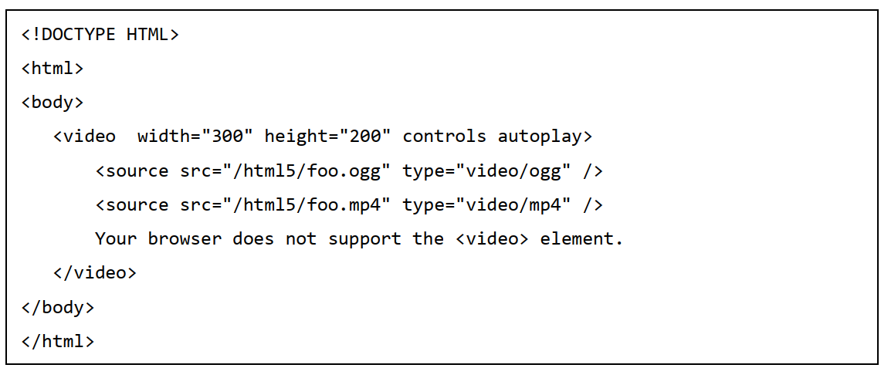
You can use <source> tag to specify media along with media type and many other attributes.
A video element allows multiple source elements and browser will use the first recognized format:

Slide 40
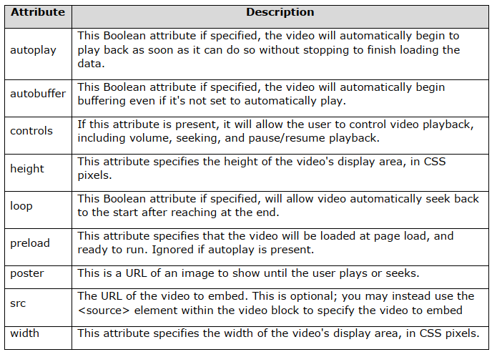

Slide 41
Adding Video with Preload
Example: We have embedded the HTML video along with the source link and preload functionality.
<!DOCTYPE html>
<html>
<body>
<video width="450" height="250" controls preload="auto"> <source src=“source1.mp4" type="video/mp4">
</video> </body> </html>
The controls attribute is used to add controls like play, pause, volume, etc, & the “source” element is used to specify the video that the browser will choose to play.
<video width="400" height="350" autoplay>
<source src="myvid.mp4" type="video/mp4">
<source src="myvid.ogg" type="video/ogg">
</video>

Slide 42
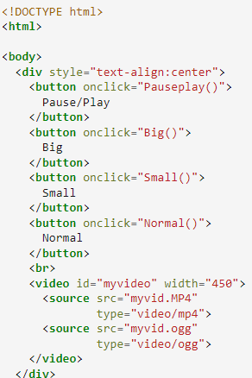
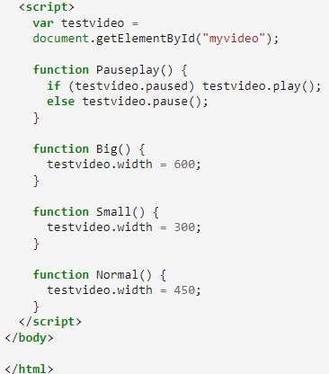
HTML Video using JavaScript
Many properties and events can be set for a video like load, play and pause videos, as well as setting duration and volume.

Slide 43
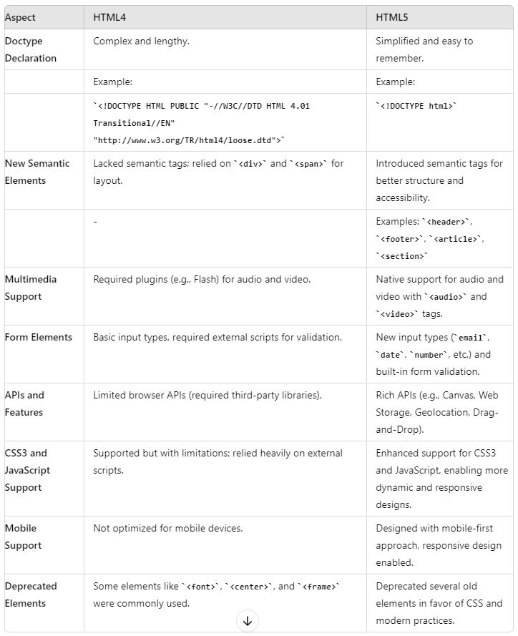
Difference between HTML4 and HTML5

